Slide 1
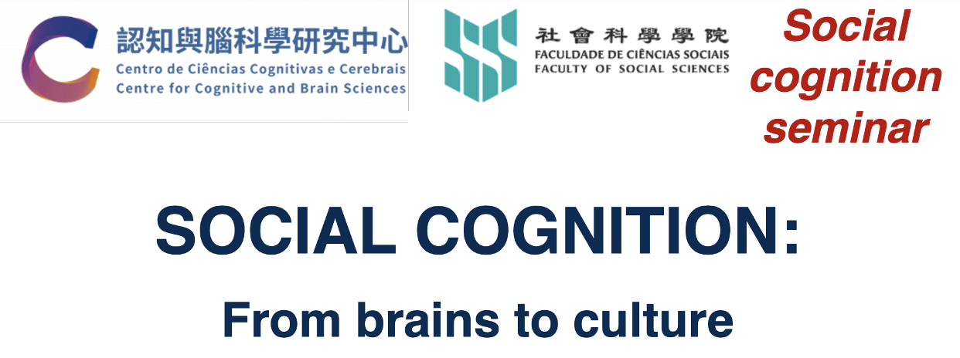



Ch 11 Stereotyping: Cognition and Bias
ANDlab social_cognition_seminar
Haiyan Wu

Slide 2



Slide 3
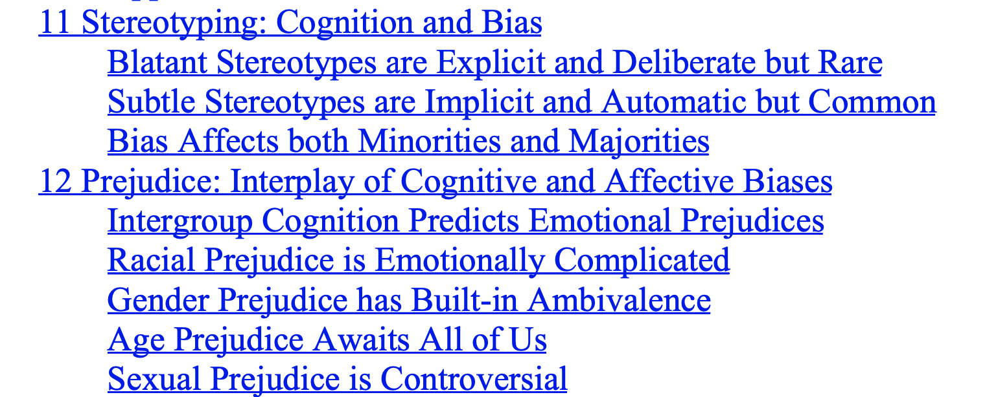

Slide 4
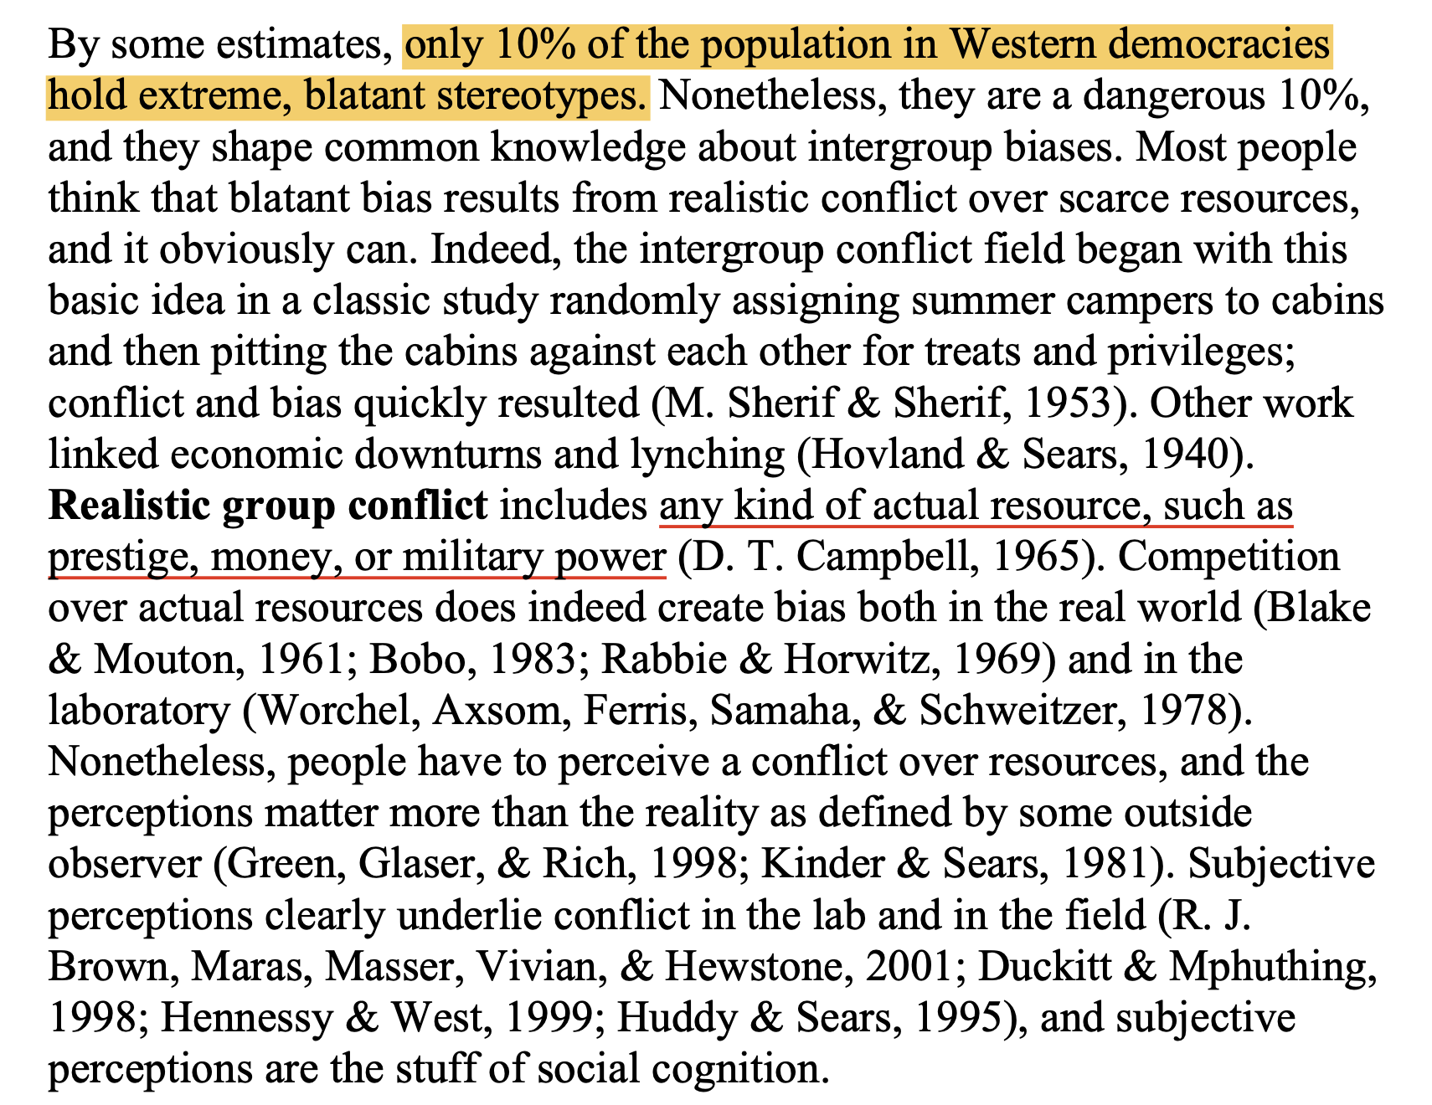
Blatant Stereotypes are Explicit and Deliberate but Rare

Slide 5
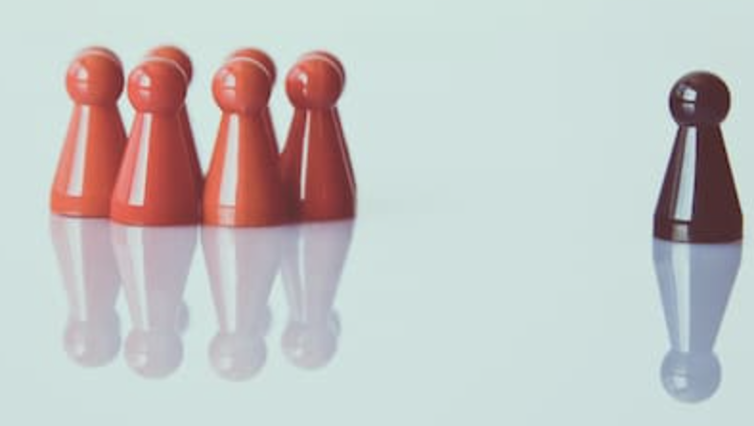
Social Identity, Self-Categorization, and Other Identity Theories
Social identity theory (SIT)
Minimal group paradigm
societally devalued groups carve out a positive social identity by emphasizing certain dimensions of their identity as relative advantages.
categorization into ingroup and outgroups reduces perceived variability within the category, while increasing perceived variability between categories.
(Tajfel, 1981; Tajfel & Turner, 1979)

Slide 6
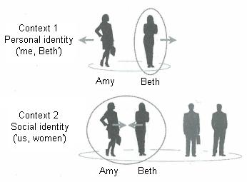
Self-categorization theory (SCT)
Comparative fit compares between-group differences to within-group differences in order to create a meta-contrast ratio.
Normative fit: socially shared meaning that defines the two categories.
optimal distinctiveness theory (ODT) (M. B. Brewer, 1991) argues that people balance individual autonomy and distinctiveness against belonging to the right group, in order to reach a self-affirming, satisfying identity.
Subjective uncertainty reduction theory (Hogg, 2001) proposes that ingroup norms reduce anxiety, especially when people are unsure in self-relevant domains

Slide 7
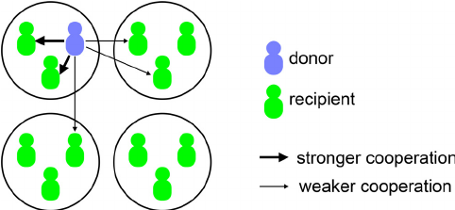
Ingroup Favoritism (1)

Slide 8
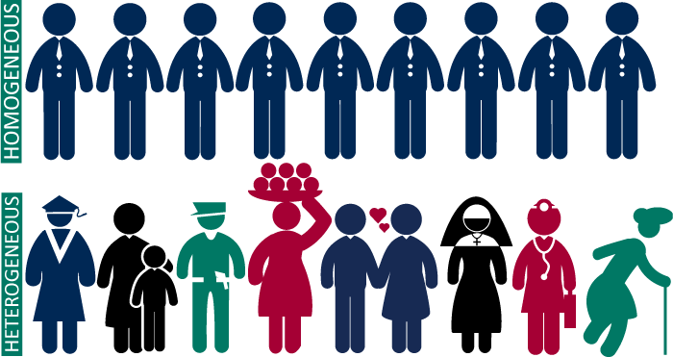
Group Homogeneity (2)
when intergroup distinctions are salient (because of threat or conflict), both ingroups and outgroups are seen as more homogeneous

Slide 9

Social Dominance Theory
group hierarchies are universal and even adaptive in societies beyond the hunter-gatherer stage. Some groups inevitably dominate others, and stable hierarchies regulate pointless conflict (however much the oppressed groups might wish it otherwise)

Slide 10
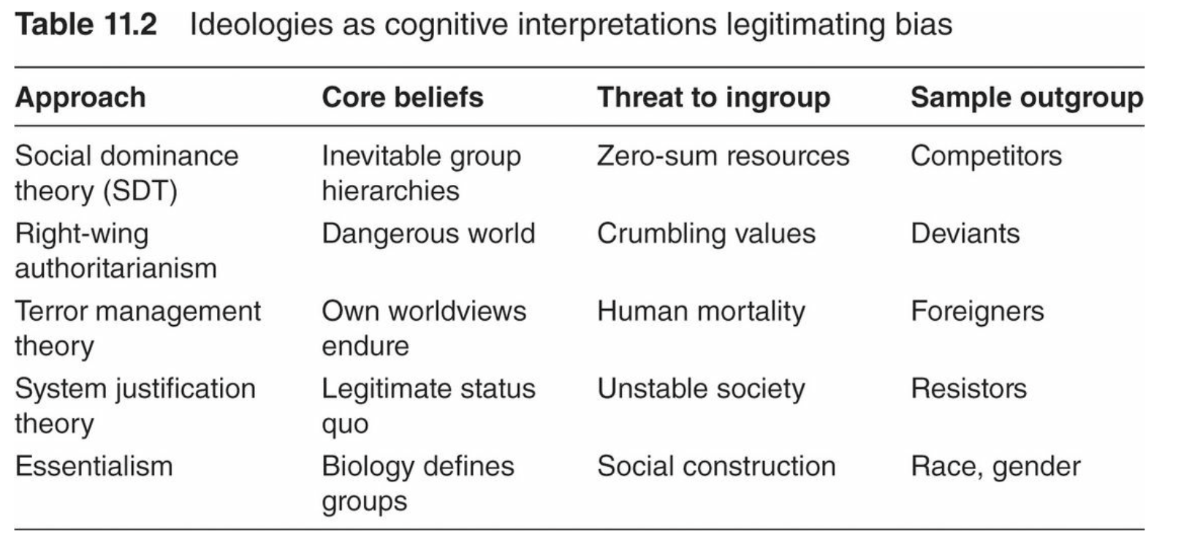
Social Dominance Theory

Slide 11
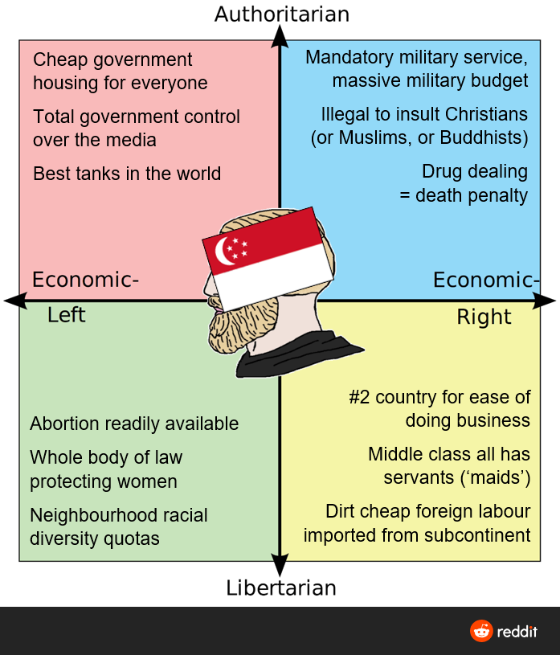
Right-Wing Authoritarianism
RWA correlates with punitive parenting, social conformity, and viewing the world as dangerous (Duckitt, 2001)

Slide 12
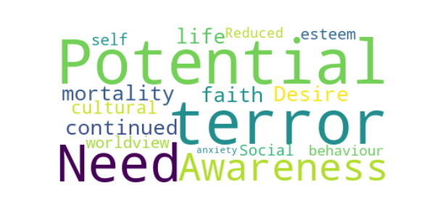
Terror Management Theory
people seek to transcend death by identifying with their ingroups, which will outlive them (Castano & Dechesne, 2005). Under threat to self, people preserve the familiar, and this includes reacting against outgroups (Burris & Rempel, 2004). People respond harshly to deviant outgroups

Slide 13
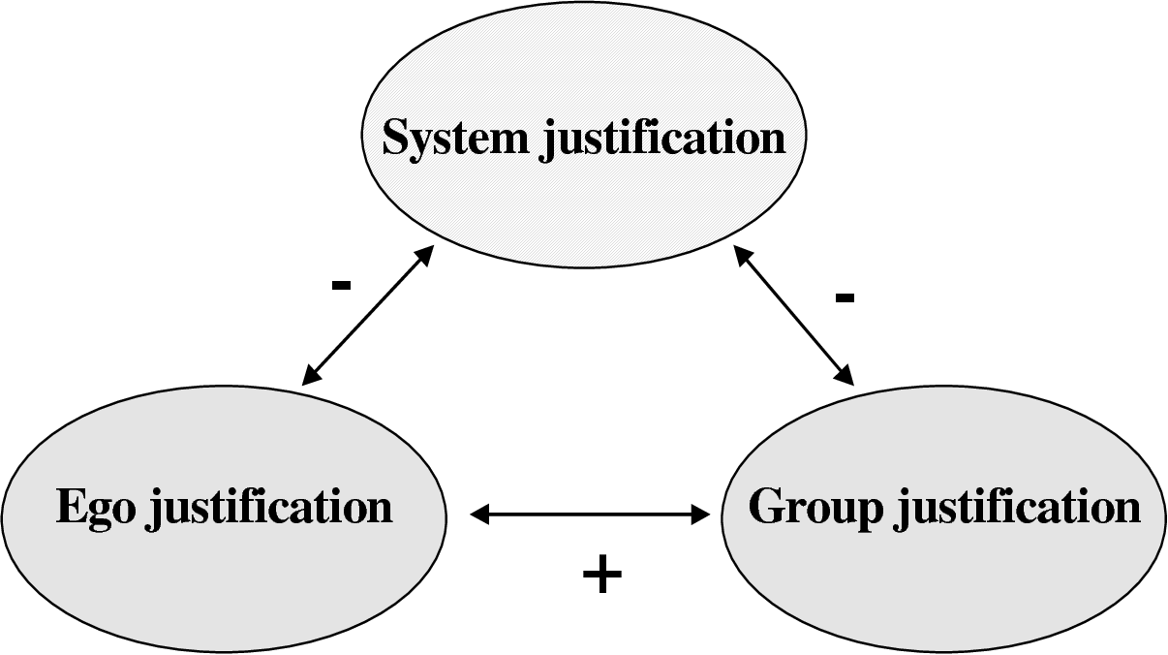
System Justification Theory
people seek to legitimate the status quo (e.g., Jost & Banaji, 1994)
disadvantaged groups accept their status, feel less entitled, favor higher status groups, and support the system despite their own best interests (Jost, Banaji, & Nosek, 2004)

Slide 14
Entitativity and Its Heirs
Once categorized, groups seem to possess entitativity (D. T. Campbell, 1958)
Essentialism(本质主义) reinforces stereotypes
Infrahumanization 超人性化 and Dehumanization 非人性化

Slide 15
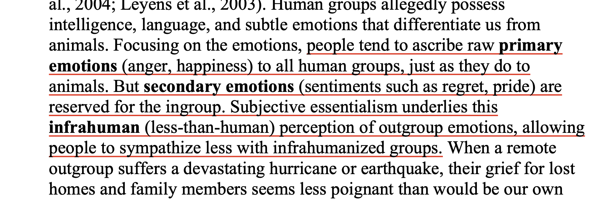

Slide 16
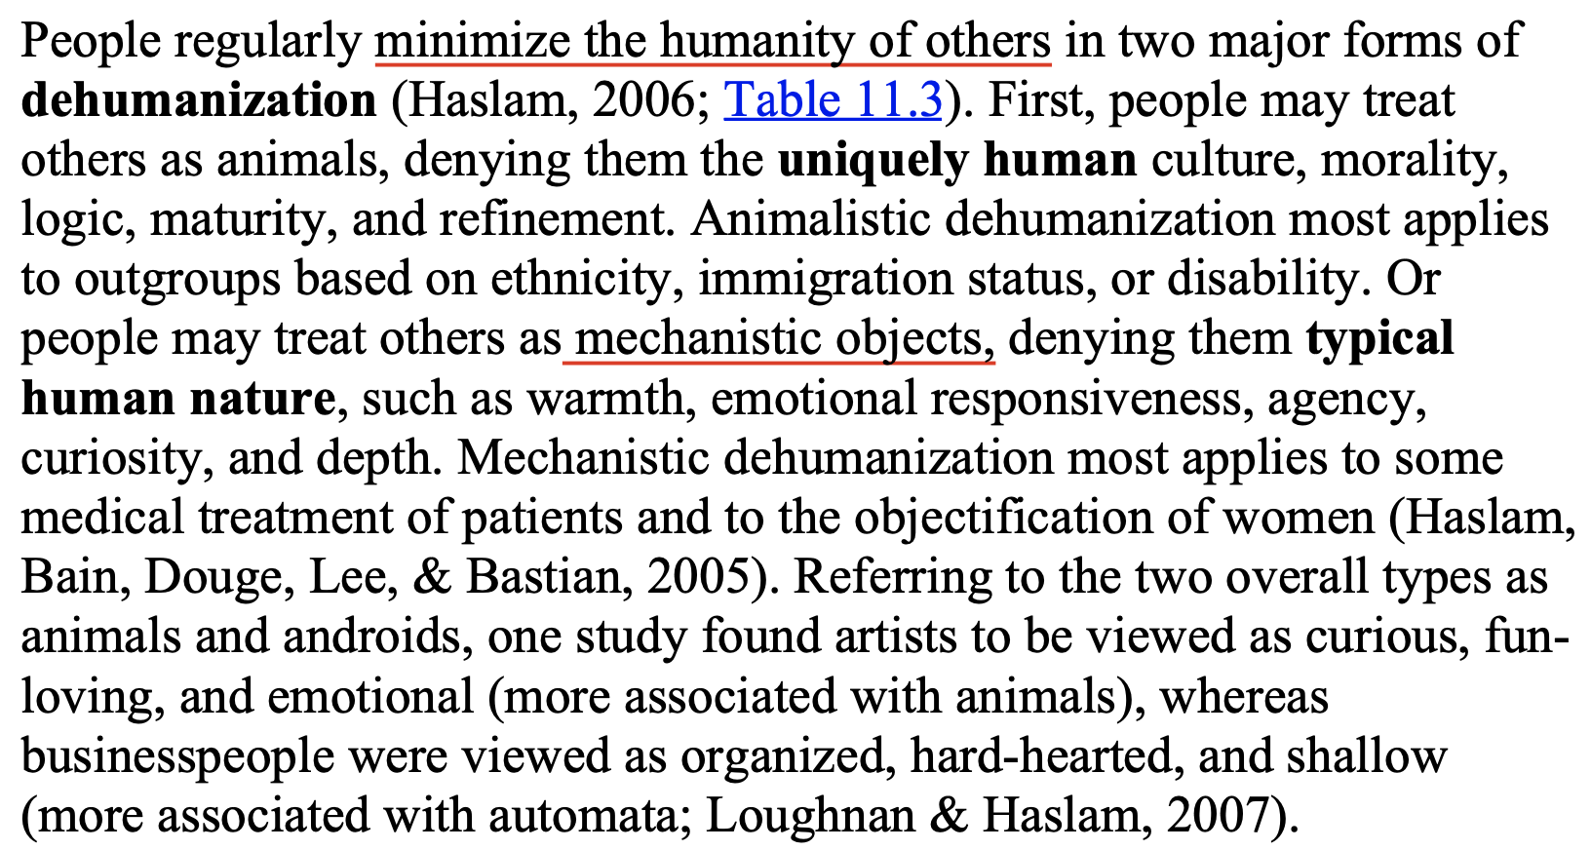

Slide 17
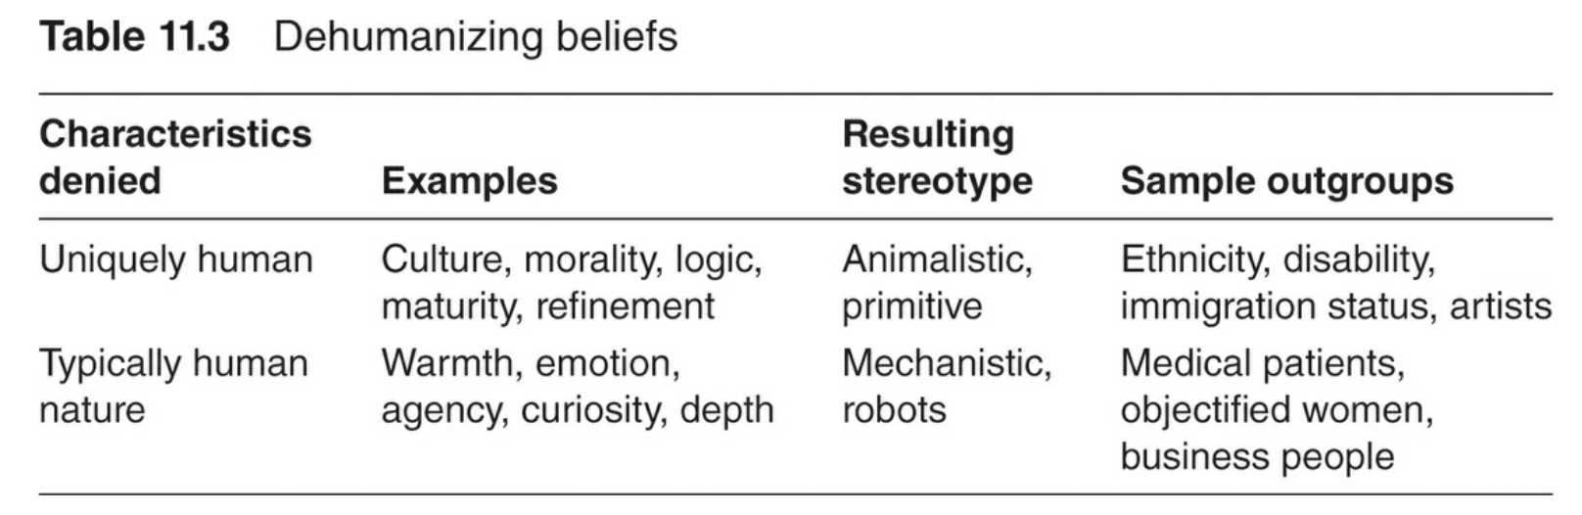
Subtle Stereotypes are Implicit and Automatic but Common
Psychologists have developed training techniques to reduce judgmental errors, and ironically, at least some of these efforts actually increase the dilution effect

Slide 18
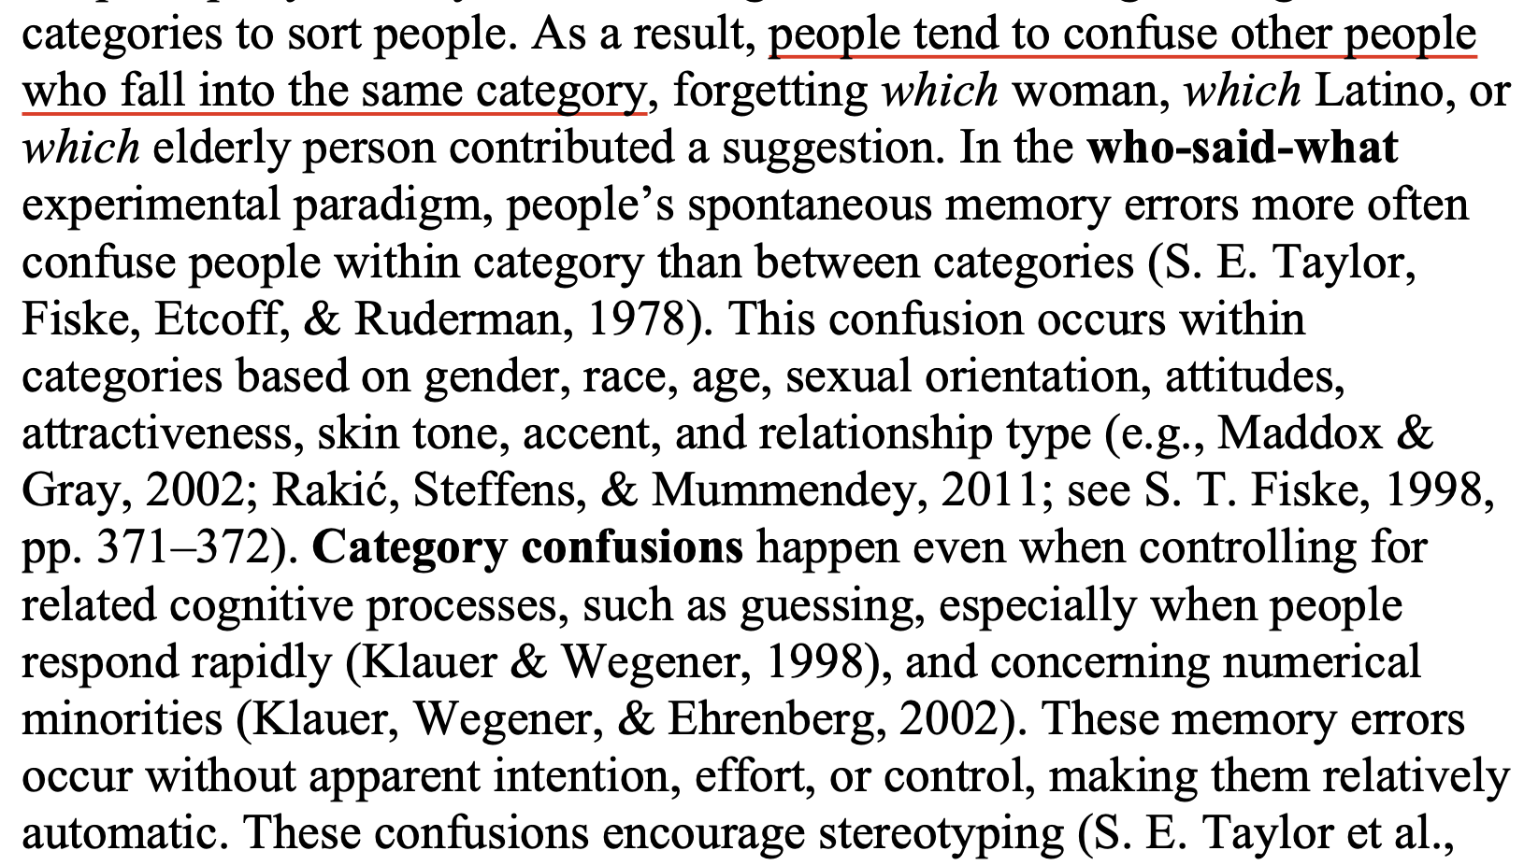
Automatic Stereotyping
Category Confusions

Slide 19
Automatic Stereotyping
Aversive Racism
Indirect Racial Attitudes
Implicit Association Test
Stereotyping and Cognitive Load
most White people as well intentioned and rejecting their own racist beliefs
facilitation (speed-up) for some people’s responses to negative or stereotypic terms following an outgroup prime provides an indirect index of racial attitudes.

Slide 20
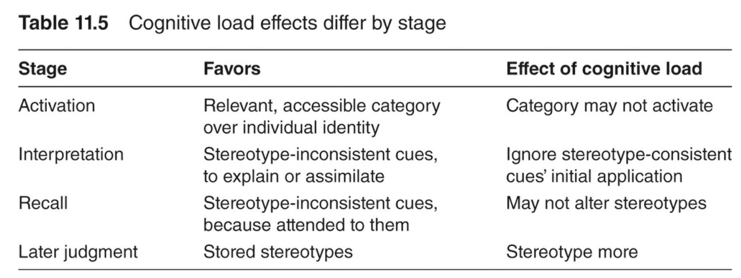

Slide 21
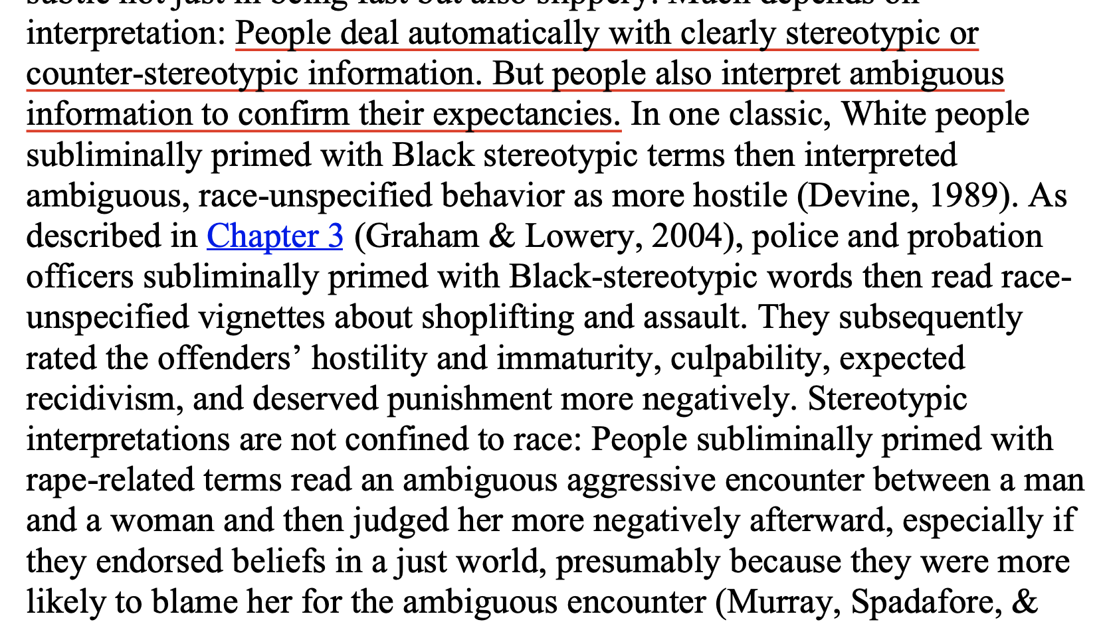
Ambiguous Stereotyping

Slide 22
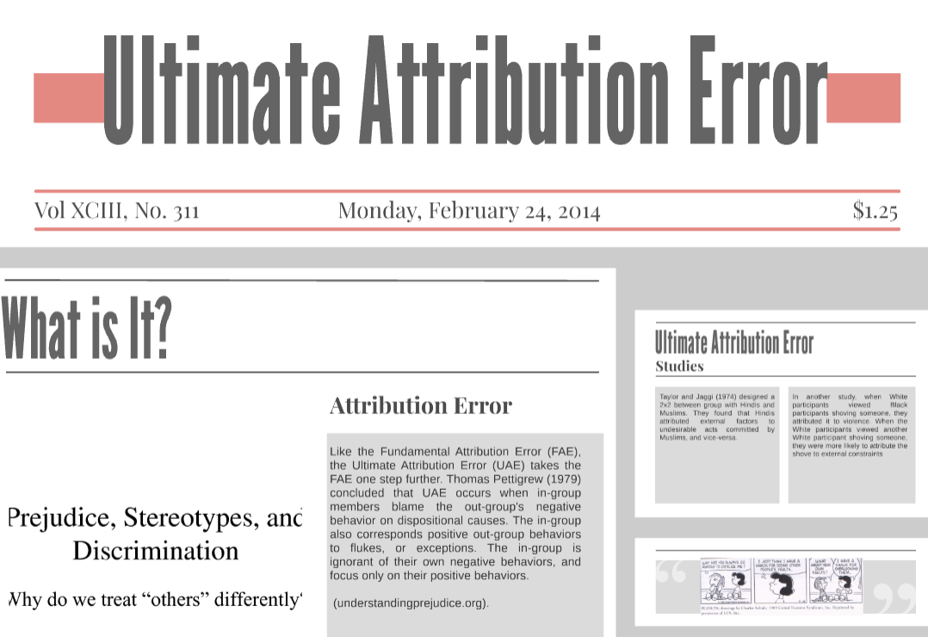
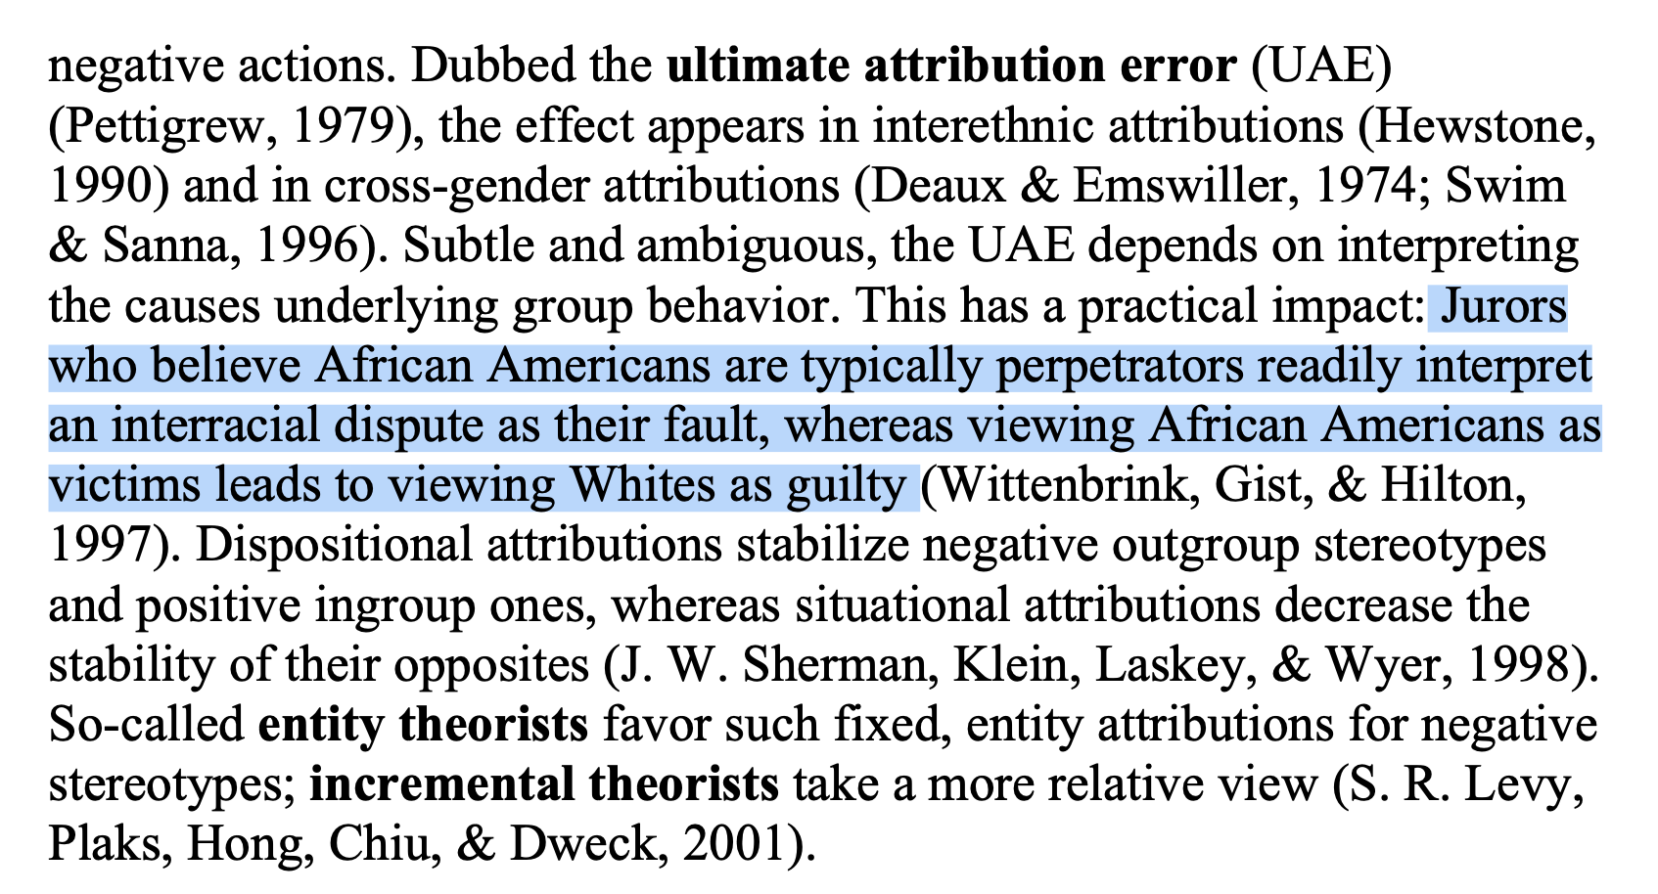
Ambiguous Stereotyping
ultimate attribution error

Slide 23
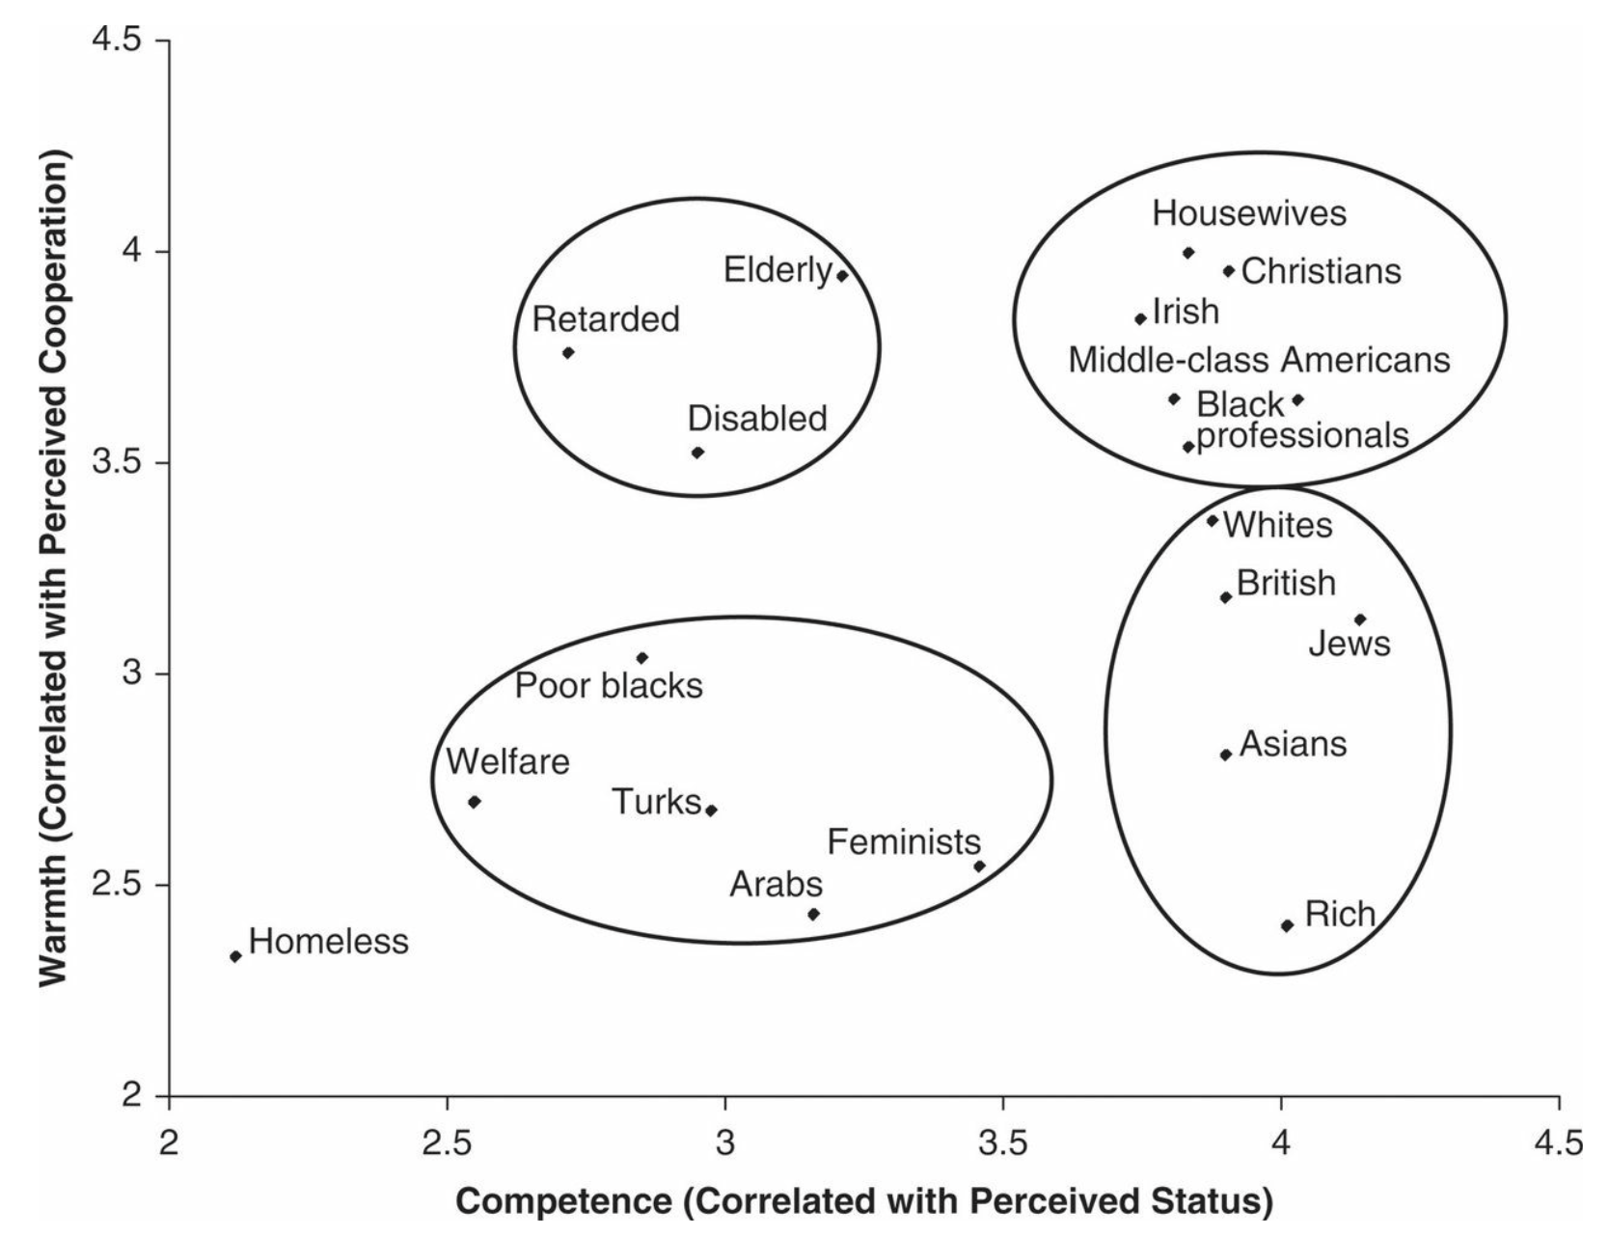
Ambivalent Stereotyping
perceived mixed stereotypes
stereotype content model (SCM)

Slide 24
Attributional Ambiguity
As with all negative events, experiences of bias make people appraise the threat and subsequently cope. When intergroup interactions go badly, targets sometimes cope by blaming prejudice instead of their own behavior, thereby protecting their self-esteem (Major, Quinton, & McCoy, 2002)
Targets are, however, reluctant to attribute negative outcomes to prejudice because of the social as well as personal costs

Slide 25
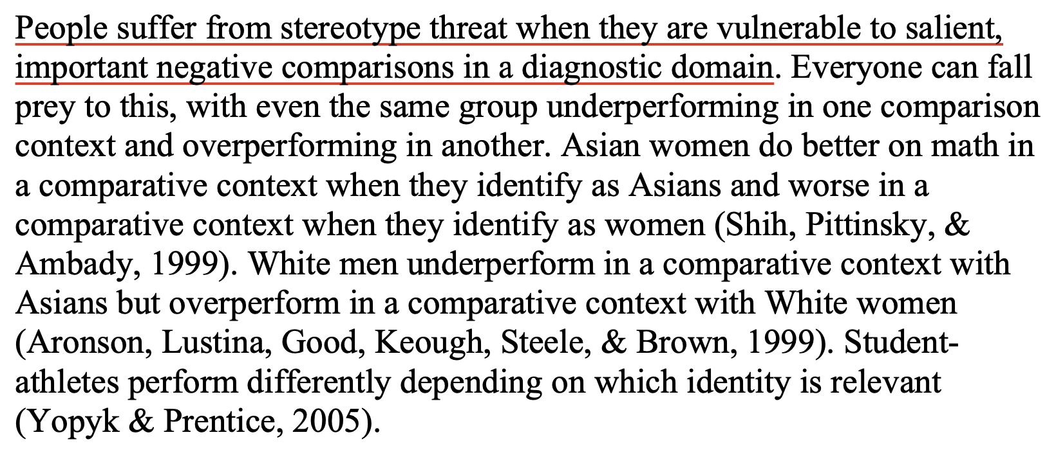
Stereotype Threat

Slide 26
Minority Identity and Well-Being
Well-being is closely tied to private aspects of collective self-esteem (Crocker & Luhtanen, 1990)
In various identity domains, private regard for one’s identity seems more adaptive than relying on public regard
Identity also shapes perceived discrimination.

Slide 27
Majority Concerns
Concerns with the other person’s stereotypes of self (called meta-stereotypes) cause majority members to focus on themselves and how they are viewed (Vorauer, Hunter, Main, & Roy, 2000). This public self-consciousness, as noted, depletes majority group members’ executive function during and after the interaction

Slide 28
Further Reading
Bodenhausen, G. V., Kang, S. K., & Peery, D. (2012). Social categorization and the perception of social groups. In S. T. Fiske & C. N. Macrae (Eds.), Sage handbook of social cognition (pp. 311–329). Thousand Oaks, CA: Sage.
Dovidio, J. F., & Gaertner, S. L. (2010). Intergroup bias. In S. T. Fiske, D. T. Gilbert, & G. Lindzey (Eds.), Handbook of social psychology (5th ed., Vol. 2, pp. 1084–1121). Hoboken, NJ: Wiley.
Hewstone, M., Rubin, M., & Willis, H. (2002). Intergroup bias. Annual Review of Psychology, 53, 575–604.
Kay, A. C., & Eibach, R. P. (2012). Ideological processes. In S. T. Fiske & C. N. Macrae (Eds.), Sage handbook of social cognition (pp. 495–515). Thousand Oaks, CA: Sage.
Nosek, B. A., Hawkins, C. B., & Frazier, R. S. (2012). Implicit social cognition. In S. T. Fiske & C. N. Macrae (Eds.), Sage handbook of social cognition (pp. 31–53). Thousand Oaks, CA: Sage.
Yzerbyt, V., & Demoulin, S. (2010). Intergroup relations. In S. T. Fiske, D. T. Gilbert, & G. Lindzey (Eds.), Handbook of social psychology (5th ed., Vol. 2, pp. 1024–1083). Hoboken, NJ: Wiley.
552

